Slide 1
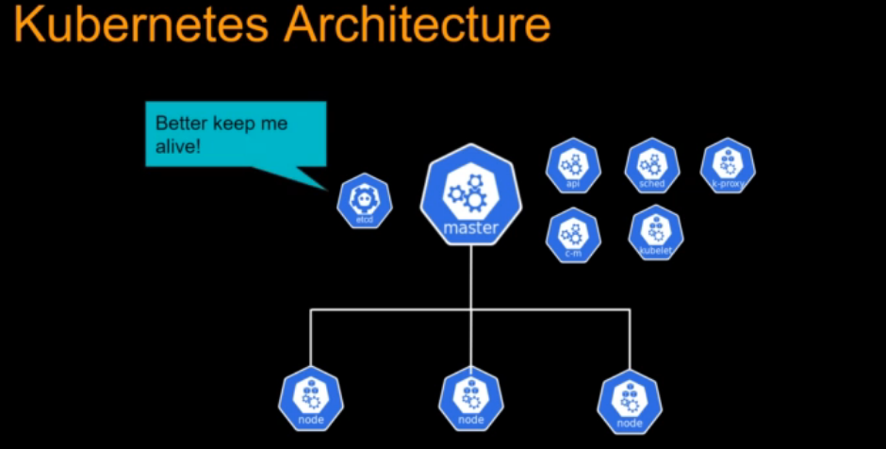

Slide 2
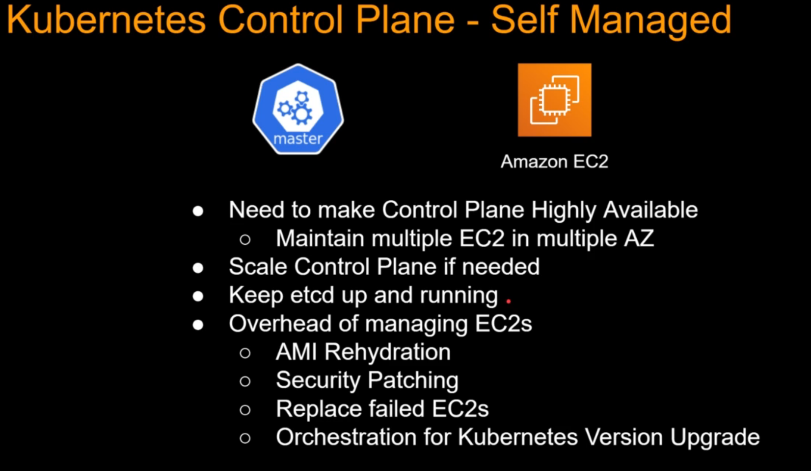

Slide 3
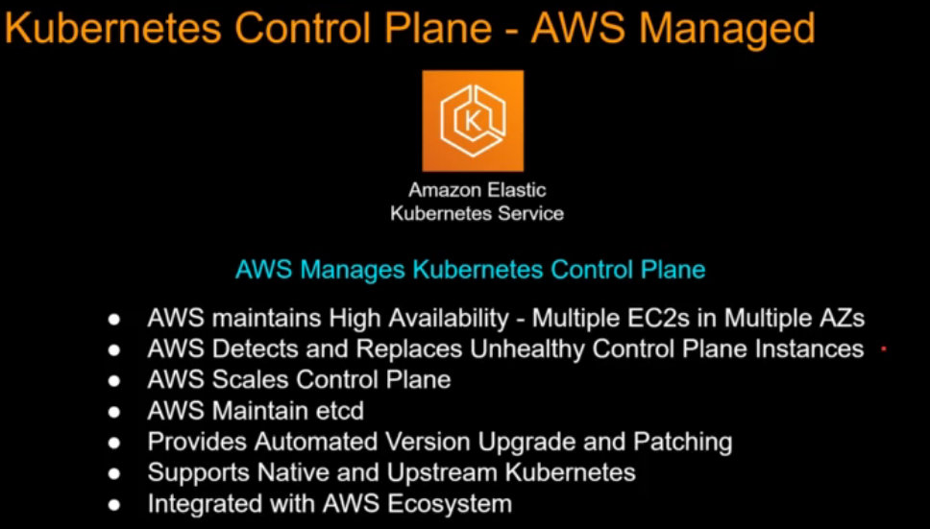

Slide 4
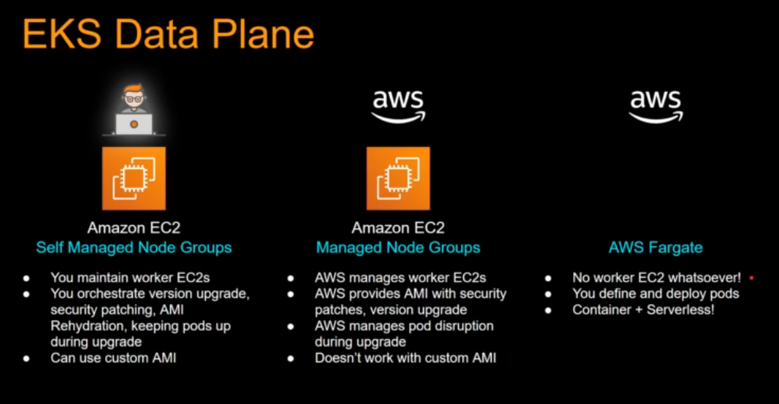

Slide 5
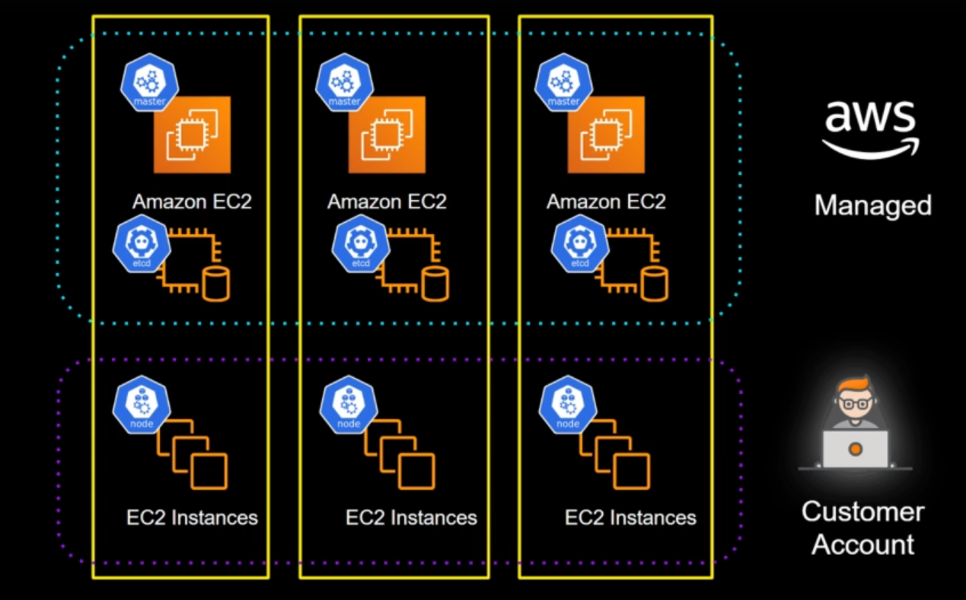

Slide 6
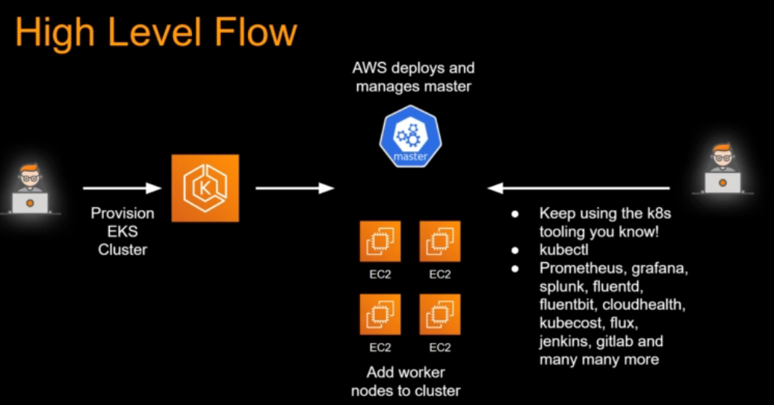

Slide 7
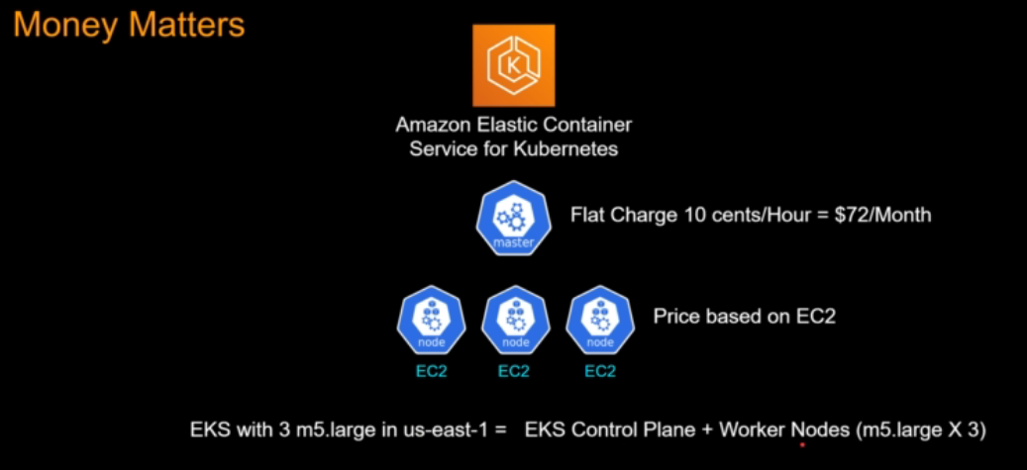

Slide 8
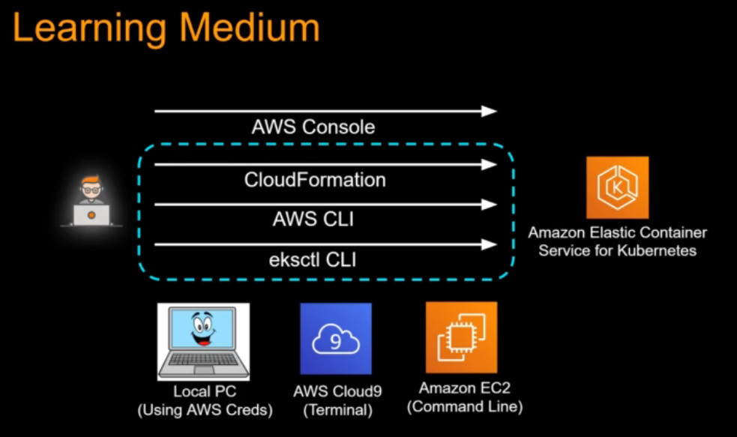

Slide 9
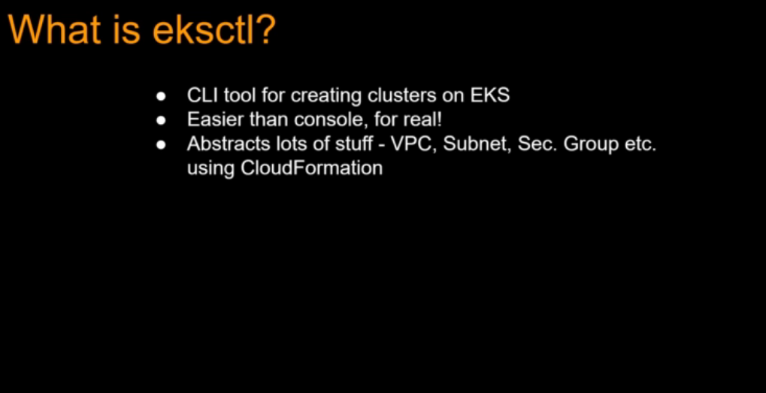

Slide 10
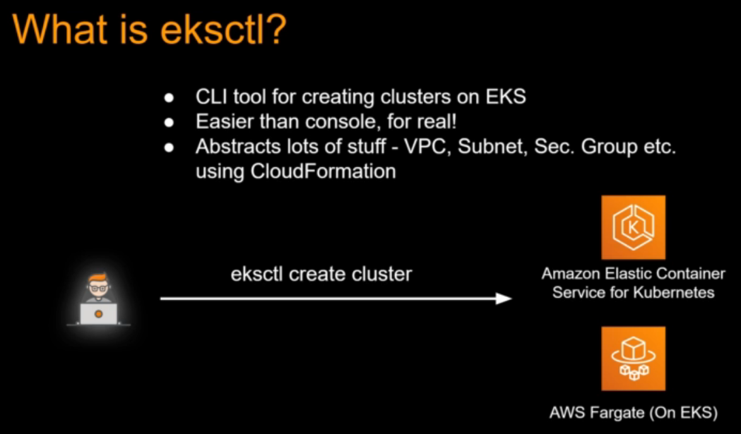

Slide 11
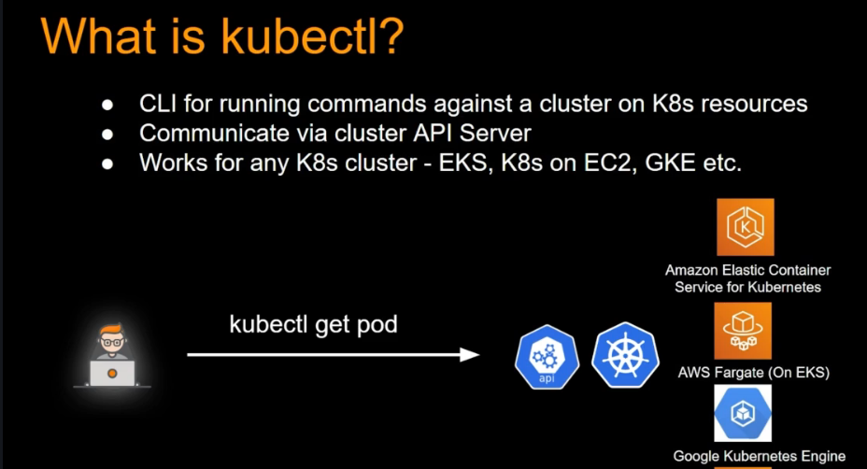

Slide 12
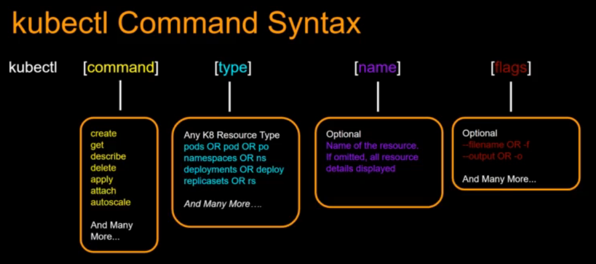

Slide 13
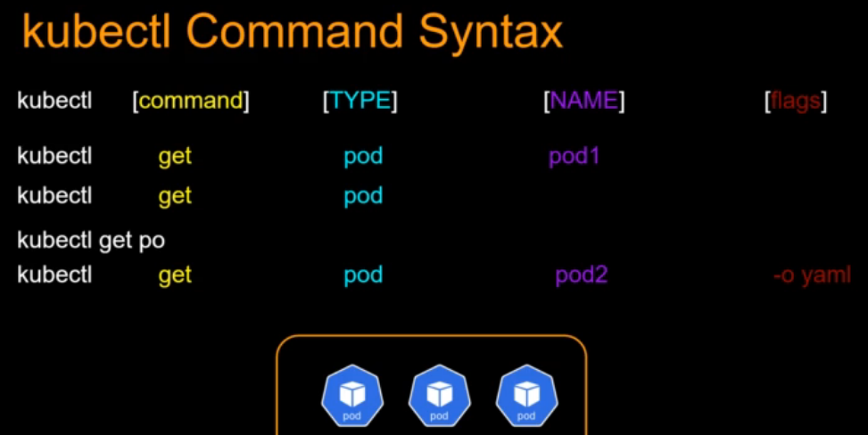

Slide 14
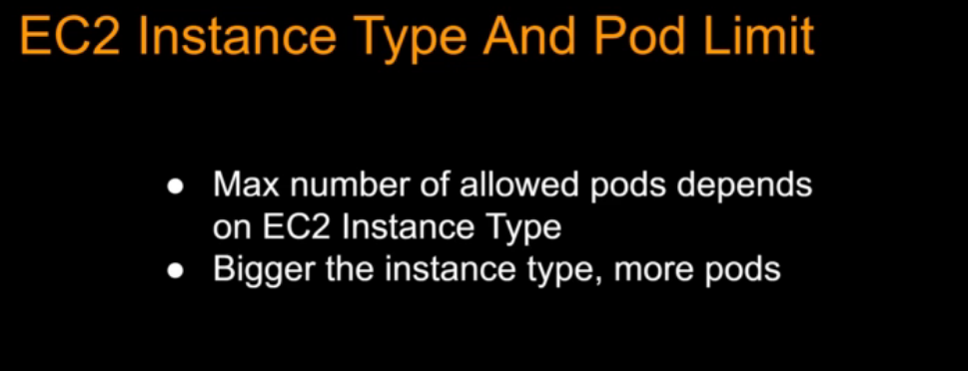

Slide 15
Install AWS CLI and Configure
C:\AWS-DevOPS\Traning-Vendors\Integrated Solutions\AWS Developer\Final\AWSCLI
Install Kubectl
https://docs.aws.amazon.com/eks/latest/userguide/install-kubectl.html
https://amazon-eks.s3.us-west-2.amazonaws.com/1.19.6/2021-01-05/bin/windows/amd64/kubectl.exe
Install Eksctl
https://docs.aws.amazon.com/eks/latest/userguide/eksctl.html
https://chocolatey.org/install
Get-ExecutionPolicy
Get-ExecutionPolicy
Set-ExecutionPolicy Bypass -Scope Process -Force; [System.Net.ServicePointManager]::SecurityProtocol = [System.Net.ServicePointManager]::SecurityProtocol -bor 3072; iex ((New-Object System.Net.WebClient).DownloadString('https://chocolatey.org/install.ps1'))
choco -?

Slide 16
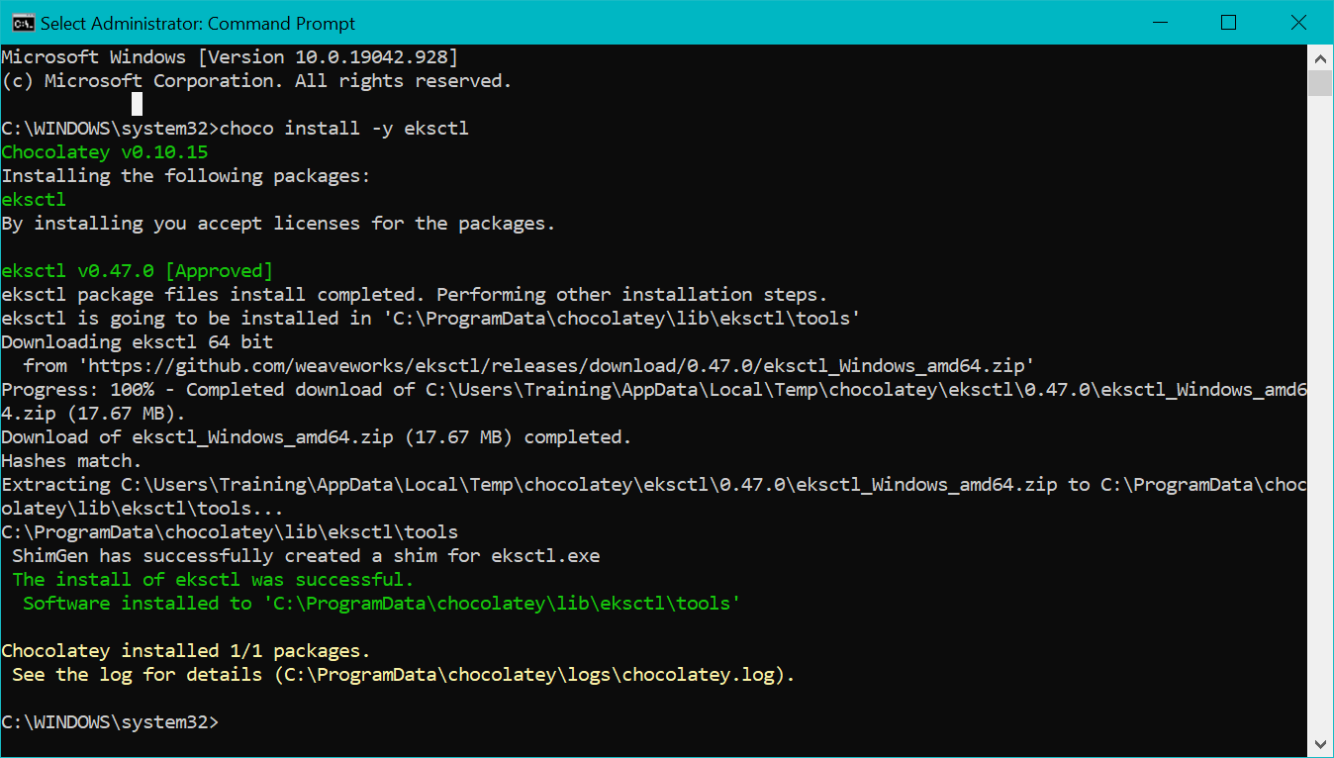

Slide 17
Install Eksctl
choco install -y eksctl
choco upgrade -y eksctl
eksctl version
Refer the eks-commands file for further deployment

Slide 18
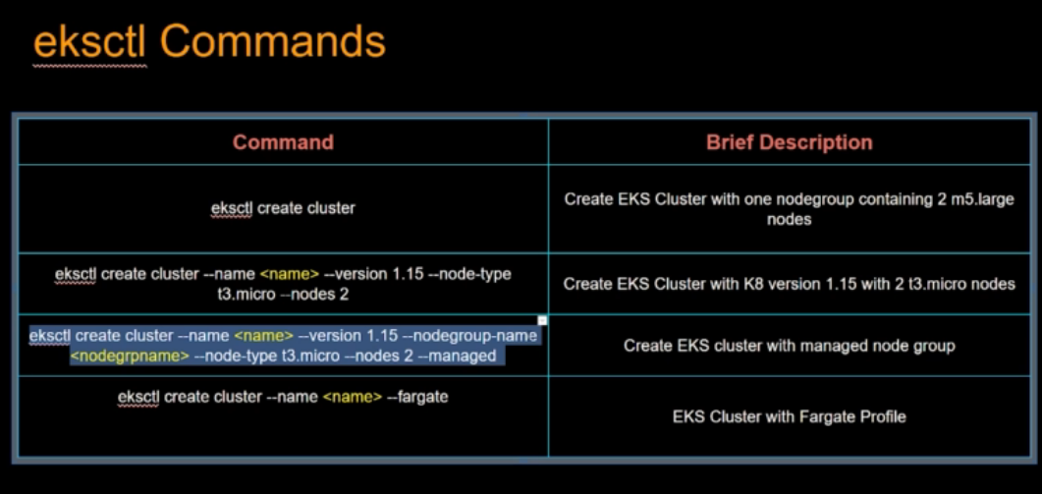

Slide 19
C:\AWS-DevOPS\Traning-Vendors\Integrated Solutions\AWS Developer\Final\EKS\eksctl-commands.txt
Notes:
C:\AWS-DevOPS\Traning-Vendors\Integrated Solutions\AWS Developer\Final\EKS\eksctl-commands.txt

Slide 20
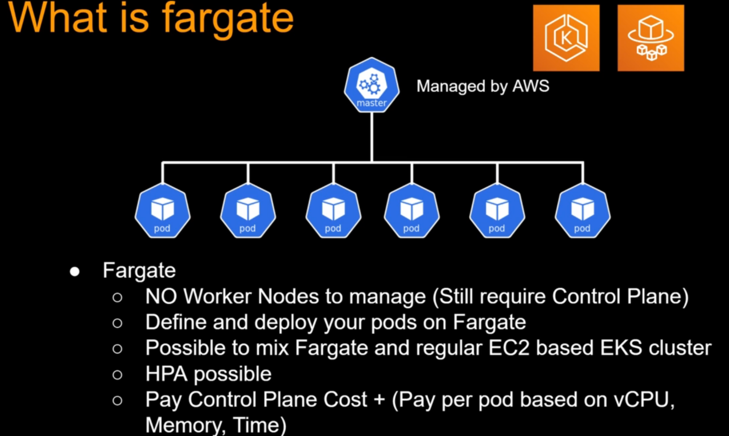

Slide 21
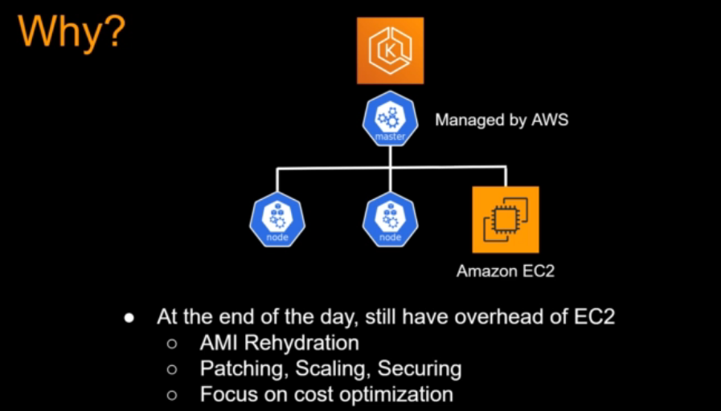

Slide 22
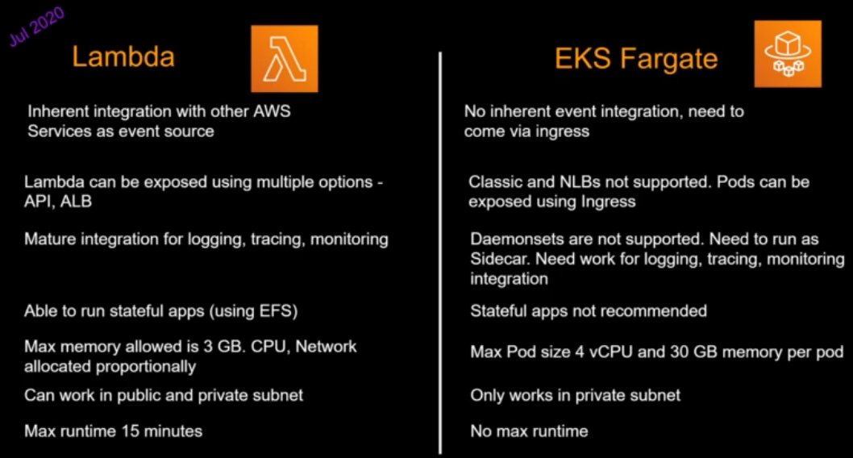

Slide 23
